Slide 1
Time Management

Slide 3
“Time management” is the process of organizing and planning how to divide your time between specific activities.
Good time management enables you to work smarter – not harder

Slide 5
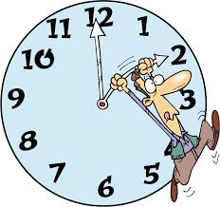

Slide 6
7 Steps to More Effective Time Management
Step 1 – Write a To Do List
Step 2 – Remove Yourself From Distraction
Step 3 – Take Breaks When Working
Step 4 – Break Big Tasks Up Into Smaller Chunks
Step 5 – Find Your Most Productive Times
Day 6 – Become More Efficient
Day 7 – Accept Your Limitations

Slide 7
Pareto Principle

Slide 8
A- مهم و فوری
B- مهم اما غیر فوری
C- غیر مهم اما فوری
D- غیر مهم و غیر فوری

Slide 9
Best Time???

